Slide 1
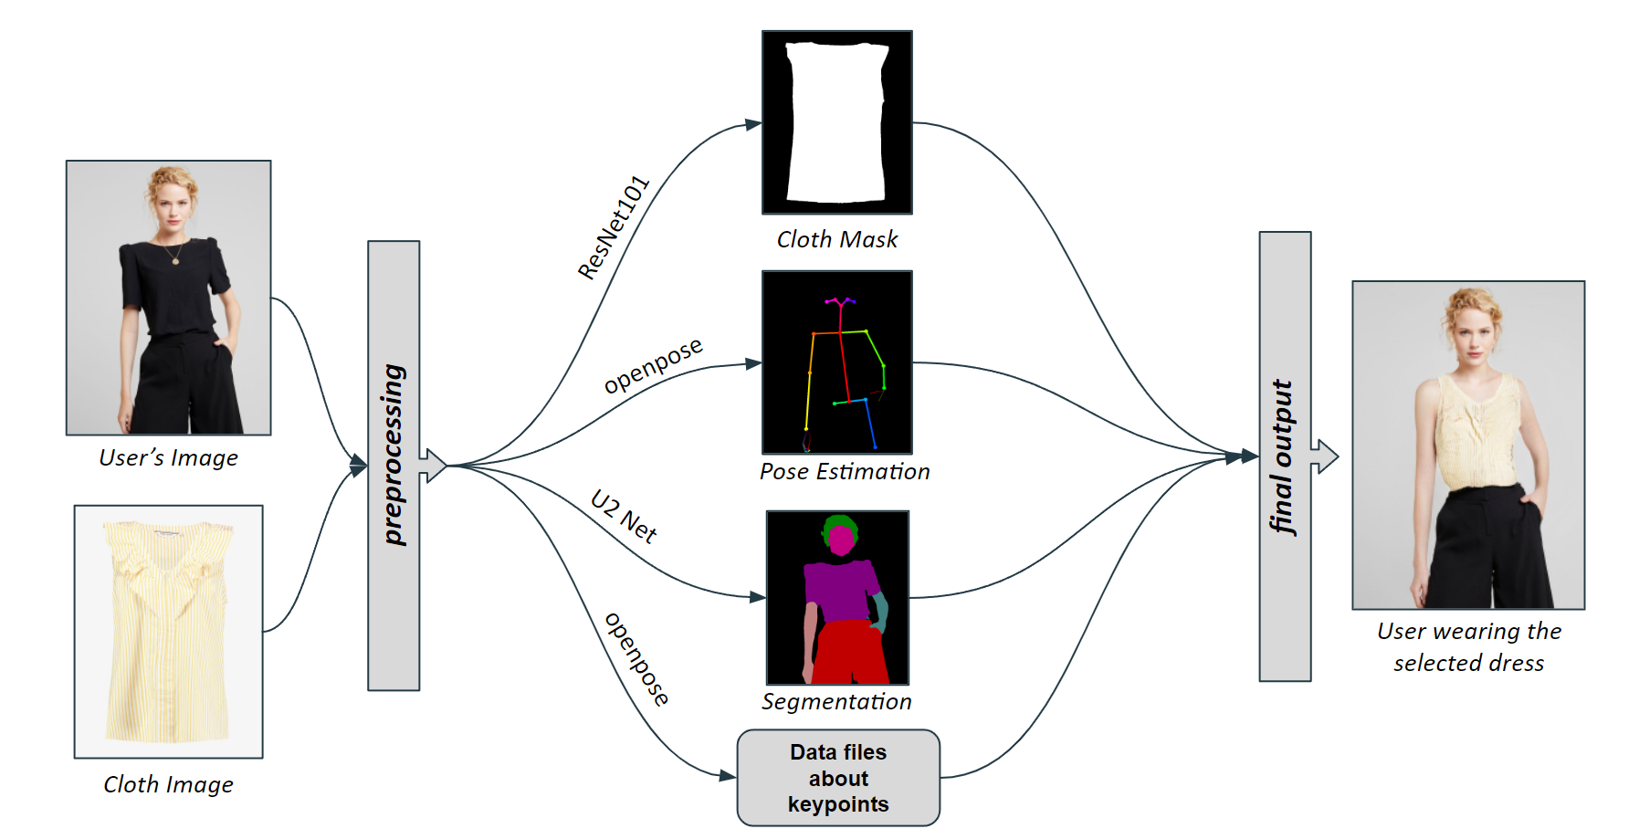
Introduction
In the rapidly evolving digital landscape, the fashion industry seeks innovative solutions to enhance online shopping experiences. Despite significant advancements in this area, the quality of the resulting images often falls short, primarily due to their limited resolution (for instance, 256x192 pixels), which doesn’t meet the expectations of online shoppers. By leveraging high-resolution imagery and advanced algorithms, VTON offers a remarkably realistic and detailed garment fitting experience, a new standard for accuracy and user engagement in the virtual fashion domain.
VTON - A 2D Virtual Try-ON
Dilshath Shaik, Khoury College of Compute Sciences (The Roux Institute)
Results
VTON significantly outperforms existing methods, delivering superior image quality both qualitatively and quantitatively. It demonstrates remarkable ability in preserving the details of clothing and the natural shape of the person across various resolutions.
Algorithm Development Plan
Data Preparation: Collect and preprocess images from the VTON dataset, including segmentation and annotation for accurate model training.
Figure 1 (Data Preprocessing)
System Development: Implement the VTON framework using advanced computer vision and deep learning techniques, focusing on high-resolution image synthesis and the novel ALIAS normalization for precise garment fitting.
Figure 2 (Block diagram of VTON)
Model Training: Train the VTON model on the prepared dataset, iteratively refining the model based on initial testing to optimize performance.
Evaluation: Assess the system quantitatively and qualitatively, using metrics such as PSNR, SSIM, and IoU for technical evaluation, and conduct user surveys and expert reviews for user experience insights.
Optimization: Analyze evaluation results to identify areas for improvement, optimizing the model for better accuracy, efficiency, and user satisfaction
Background
The VITON-HD project was conceived in response to the global shift towards online shopping, a transformation accelerated by the COVID-19 pandemic. As physical stores closed and the world grappled with unprecedented restrictions, the demand for an enhanced digital shopping experience, particularly in the fashion sector, became evident.
Recognizing the need for a virtual try-on solution that could mimic the in-store experience with high-resolution realism, VTON aimed to bridge this gap. By leveraging advanced technologies, the project sought not only to improve online retail during these challenging times but also to set a new standard for the future of fashion shopping.
Figure 3 (Output of VTON)
References
I would like to thank Professor Jeongkyu Lee and TA Ting Tang for their constant support.
[1]. Andrew Brock, Jeff Donahue, and Karen Simonyan. Large scale gan training for high fidelity natural image synthesis. In Proc. the International Conference on Learning Representations (ICLR), 2018.
[2]. Haoye Dong, Xiaodan Liang, Xiaohui Shen, Bochao Wang, Hanjiang Lai, Jia Zhu, Zhiting Hu, and Jian Yin. Towards multi-pose guided virtual try-on network. In Proc. of the IEEE international conference on computer vision (ICCV), pages 9026–9035, 2019.
Problem Statement
Traditional virtual try-on technologies struggle with low-resolution outputs and noticeable misalignments between the warped clothing and the person's image. These issues hamper the overall consumer experience in online fashion retail.
Specifically, these technologies struggle with accurately rendering textures, patterns, and fit across diverse body types, posing a significant challenge to achieving true-to-life virtual garment fitting.

